Slide 1
Structural alignment of proteins by a novel
TOPOFIT method, as a superimposition of common volumes at a topomax point
VALENTIN A. ILYIN, ALEXEJ ABYZOV, AND CHESLEY M. LESLIN
Protein Science (2004), 13:1865–1874.
Speaker : Chia - Hung Chang
Date : 2006-11-16

Slide 2
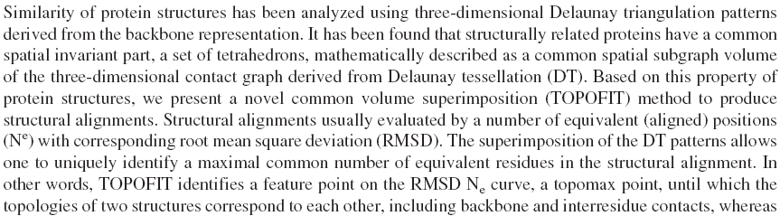
Abstract

Slide 3
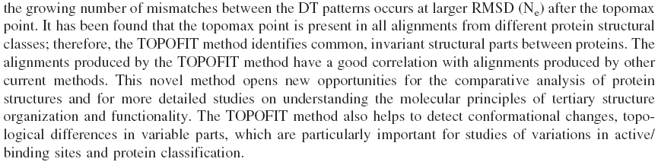
Abstract (cont.)

Slide 4
TOPOFIT method
TOPOFIT method compares spatial correspondence of the topology of contact patterns, derived by Delaunay tessellation between two protein structures.

Slide 5
RMSD
The root mean square deviation (RMSD) of aligned Cα atoms of the input structure (query) compared to the subject structure.

Slide 6
Ne
The number of equivalent (aligned) positions in a given TOPOFIT structural alignment, other names: alignment length, number of residues included in the alignment.

Slide 7
TOPOMAX POINT
The major result of the TOPOFIT method is a saturation point on this curve, a maximum number of aligned residues (Cα-atoms) where tessellation patterns correspond to each other, a "topomax" point.
Increasing alignment above the topomax point results in the beginning of the topological mismatch, reducing alignments beyond the topomax point produces an incomplete alignment.

Slide 8
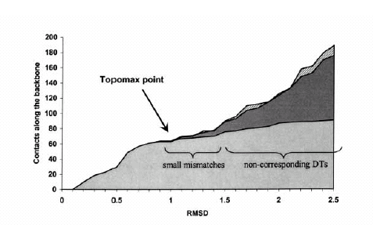

Slide 9
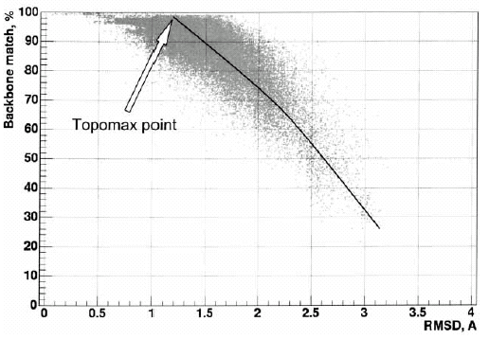

Slide 10
Delaunay tessellation (DT)

Slide 11
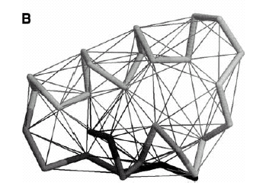

Slide 12
The comparison algorithm
Seed = (ta, tb)
Joint distance : D (a restriction parameter)

Slide 13
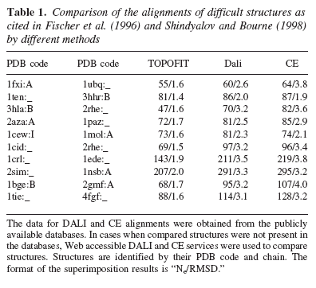

Slide 14
Active & binding sites
ο
4 ~ 7 A
4 ~ 5 A
ο

Slide 15
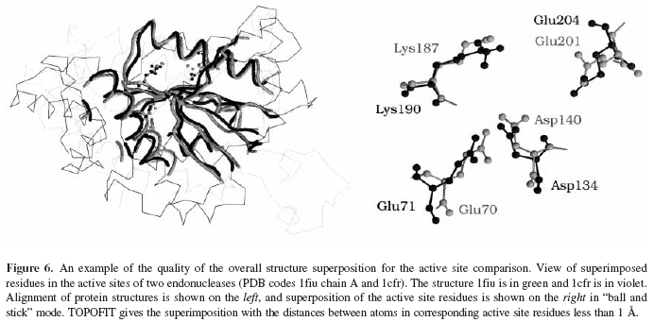

Slide 16
Z-score
For a given RMSD and Ne the Z-score was calculated as deviation of Ne from the Gaussian average µ normalized to the Gaussian σ

Slide 17
